Slide 1
Reducing and Preventing Healthcare Acquired Conditions in Massachusetts Nursing Homes
May 2013
This material was prepared by Masspro, the Medicare Quality Improvement Organization for Massachusetts, under contract with the Centers for Medicare & Medicaid Services (CMS), an agency of the U.S. Department of Health and Human Services. The contents presented do not necessarily represent CMS policy. 10-ma-ptcare-13-213-ma-coal-reducing-hac-in-ma-ppt-May13
Notes:
Reduce HACs by 40% - Nursing Homes
Phase I: providing technical assistance to nursing homes for reducing pressure ulcers and physical restraints - begins in August 2011 and continue until approximately January 31, 2013.
Phase II: expanding efforts to address other HACs (CAUTI, falls, and others) in the form of a National Nursing Home Learning and Action Network - begins on or before February 1, 2013 and continues through July 31, 2014.

Slide 2
Reducing and Preventing HACs in MA Nursing Homes
Centers for Medicare & Medicaid Services 10th Statement of Work
  Four Quality Improvement Organization Program Aims
    Make Care Beneficiary and Family Centered
    Improve Individual Patient Care
    Integrate Care for Populations
    Improve Health for Populations and Communities

Slide 3
Reducing and Preventing HACs in MA Nursing Homes
  Improving Individual Patient Care
  55 Nursing Homes recruited to work on the reduction of Pressure Ulcers and Physical Restraints
  Pressure Ulcer Homes (19) started at a rate of 11.2%, currently at 6.2% (43% RIR)
  Physical Restraint Homes (38) started at a rate of 7.7%, currently at 4.2%
Notes:
Pressure Ulcers: based on QM scores from 2nd & 3rd quarter 2010 MDS 2.0 data & 4th quarter 2010 & 1st quarter 2011 MDS 3.0 data. Nursing facilities that were > 75th percentile in the state and have a pressure ulcer rate of greater than or equal to 11%.
Physical Restraints: based on QM scores from 2nd & 3rd quarter 2010 MDS 2.0 data & 4th quarter 2010 & 1st quarter 2011 MDS 3.0 data. Nursing facilities that were > 75th percentile in the state and have a physical restraint state of greater than or equal to 4%.

Slide 4
Reducing and Preventing HACs in MA Nursing Homes
  Reducing Physical Restraints: strategies for success
    Barriers to reduction/prevention efforts:
        Dementia care: dealing effectively with adverse behaviors
        Family education
        Fear of litigation/citation for falls
    Understanding provider needs
        Provider feedback
        Professional expertise
        Knowledge from prior Statements of Work
    Interventions:
        Collaboration with MA/NH Chapter of the Alzheimer’s Association
        Family education materials
        Best practice sharing

Slide 5
Physical Restraint Reduction
Participating Nursing Homes

Slide 6
Reducing and Preventing HACs in MA Nursing Homes
  Reducing Pressure Ulcers: strategies for success
    Barriers to reduction/prevention efforts:
        Staff Education: knowledge specialty
        Patient/Family education
        Assessment processes/procedures
    Understanding provider needs
        Provider feedback
        Professional expertise and Pressure Ulcer Collaborative
        Knowledge from prior Statements of Work
    Interventions:
        Wound certification class for all participating providers
        Performance Improvement Adviser site visits to assess wound care processes/procedures/best practice implementation
        Sharing of best practices among providers

Slide 7
Pressure Ulcer Reduction
Participating Nursing Homes

Slide 8



“Reducing Antipsychotics In Massachusetts Nursing Homes Using the OASIS Curriculum”
Laurie Herndon, MSN, GNP-BC
Director of Clinical Quality
Massachusetts Senior Care Foundation
lherndon@maseniorcare.org

Slide 9

What is OASIS?
Training Curriculum
Nonpharmacological Approach
Culture Change
Resident Centered Care
Dr.Susan Wehry
Commissioner, Department of Disbabilities, Aging and Independent Living
Vermont Agency of Human Services
email: swehrymd@mac.com
3

Slide 10
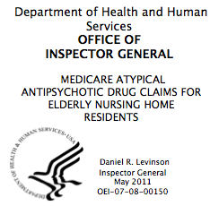

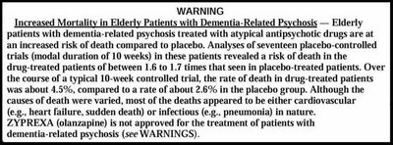
Why OASIS?
Nursing home drug use puts many at risk
Antipsychotics given to some with dementia
By Kay Lazar
Globe Staff / March 8, 2010
10

Slide 11

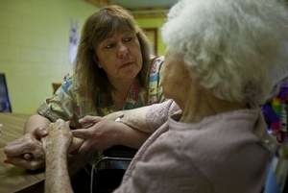


Why OASIS ?
15

Slide 12
OASIS As The Foundation
Team Based Approach To Medication Reductions
Critical Thinking About When Medications Are Appropriate
Meet Frontline Staff Need for Concrete Strategies To Use For Behavioral Symptoms
16

Slide 13

Why OASIS?
“Work with me instead of against me”
“It’s all about approach with me”
“Each day is the best day…and the “best” is defined by
each individual resident”
“No problem is too established or too ingrained to overcome”
“Everybody has the right to have a bad day/bad week”
14

Slide 14
OASIS: The Participating Facilities
Pilot Facilities n=11 | Statewide Dissemination n=100
Commonwealth Corporation | DPH Civil Monetary Penalties
August 2011-August 2012 | Sept 2012-Sept 2013
Curriculum Evaluation | Statewide Dissemination
Application Priority: Culture Change | Enrollment Priority: High Rates
Internal Data Tracking | Nursing Home Compare
All receive 1:1 technical support;regional meetings | Targeted technical support; webinars; regional meetings
9

Slide 15
Lessons Learned:
Facility Level
Sustainability
*Code of Conduct
*Annual Competency
*Orientation
*Hardwiring into every
meeting
*”Emotional Well Being
Committee”
“This part of it has really got to be stressed..the buy in part of it...that this is a lifetime change, not just a program you are in.”
OASIS Coordinator
17

Slide 16
Lessons Learned:
Staff Level
Big motivator is getting to know the residents
“We can change patient’s lives by really LOOKING at the behavior…”
“It was the CNAs that let us know….(about a visit from a family member that triggered throwing things)
“I found out things about my residents that I didn’t know’
18

Slide 17
Lessons Learned:
The Data
Baseline | After Intervention
26.3% | 21.3%
*Self reported average prescribing of antipsychotics
*OASIS pilots with bigger decrease (16% vs. 2%) in % long stay residents taking antipsychotics compared with facilities not in pilot
*OASIS pilots more likely to demonstrate a decrease than those not in pilot (90% vs 54%)
Most recent update to NH Compare (April 2013) reveals sustained improvement:
19

Slide 18
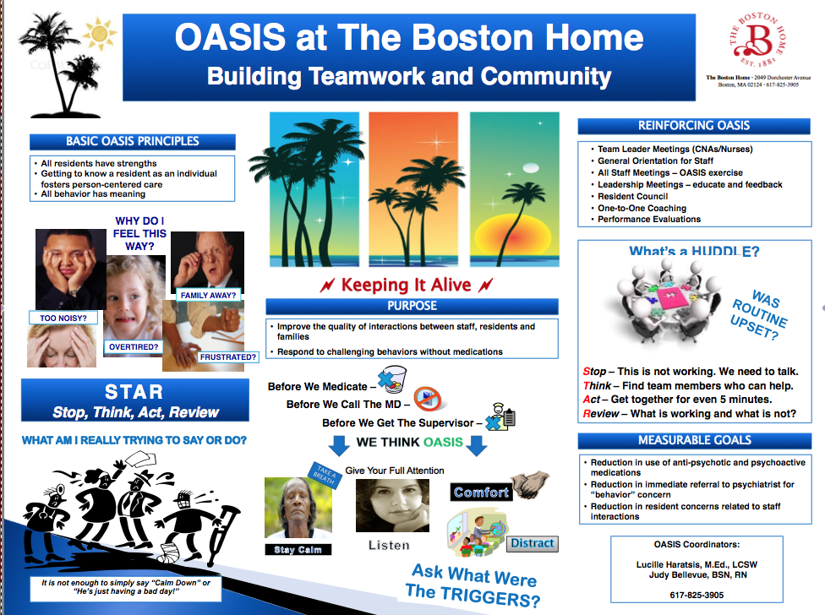
To Be Continued:
Local spread within organizations
Grassroots growth of champions who can spread work
Evaluation of current project
Ongoing collaboration with DPH for further spread
19

Slide 19
Reducing Preventable Readmissions and HAIs:
The SPIA Approach
Patricia M. Noga, PhD, RN
May 20, 2013
Notes:
Focus your presentation on what you learned about the challenges of involving leadership?
What helped? – What were the barriers?
What would you have done differently in your approach?

Slide 20
MHA's SPIA:
Statewide Performance Improvement Agenda
Improve quality by reducing preventable mortality
Improve efficiency by reducing preventable readmissions
Improve safety by reducing in central line-associated bloodstream infections (CLABSI)

Slide 21
Board Resolution
Massachusetts Hospital Boards’ Commitment to National Patient Safety Improvement Goals
As hospital trustees, we take our responsibilities to provide safe, high quality patient care very seriously. We know continued improvement demands leadership, dedication, and innovation and we are actively engaged in promoting improvements in quality and patient safety in our organization. The Massachusetts Hospital Association adopted a new statewide initiative to move beyond pioneering public reporting and transparency to make measurable, concrete improvements in hospital performance.
The Massachusetts Hospital Association adopted the American Hospital Association (AHA)’s proposed Strategic Performance Commitment that focuses on advancing a healthcare delivery system that improves health and healthcare, with three specific targets:
Quality: reducing the national mortality rate;
Efficiency: reducing the national readmissions rate;
Safety: reducing the incidence of central line associated bloodstream infections (CLABSI).
The Board of Trustees (Directors) of ____________________________________ supports this initiative which will seek to enhance care not only in Massachusetts but across the nation. As trustees, we pledge to actively engage in activities that advance our hospital’s work on these three measures through the following actions:
Devoting time at each Board meeting to be informed of issues related to patient safety and quality
Advocating for health care policies that support these measures
Working with staff and administration to ensure our hospital achieves measurable results related to improved
quality and safety.
Adopted on _______________, 20___, by ________________________________
(Hospital Board)
Signed by __________________________________________________________
Chair, Board of Trustees (Directors)

Slide 22
MHA's SPIA: Implementation Results
100% hospital boards signed on (2010-2012)
Mortality Learning-IN-Network (M-LiNk) (2012)
STAAR implemented (2009-present)
  50 hospitals enrolled
CLABSI collaborative implemented (2010-2012)
  19 hospitals enrolled
MA Hospital Engagement Network (2012-2013)
  Majority of hospitals in state enrolled in a HEN
SPIA on PatientCareLink (ongoing)
    Collaborative Resources
    Statewide Aggregate Data Trending
Notes:
Focus your presentation on what you learned about the challenges of involving leadership?
What helped? – What were the barriers?
What would you have done differently in your approach?

Slide 23
SPIA: Leadership Lessons
Engage Hospital and Community Leaders at Many Levels
  MHA Board and Committee Members
  Hospital Board of Trustee Members
  CEOs & Hospital Senior Leaders
  Hospital Quality & Safety Leaders
  Community Partner Leaders
Strive to Keep the Goal a Priority: “Always on the Agenda”
Use a Multi-Method Approach to Keep Work “Top of Mind”
  Board, Committee, Patient Care Unit Meetings
  MHA Communications that are timely; share progress and stories
  www.patientcarelink.org
  Presentations at meetings & organizations to share the goal and progress
  Reaching out to hospitals, sharing resources, providing support as needed
  Responding to impact of changing landscape of hospital affiliations, mergers, care networks
Notes:
Focus your presentation on what you learned about the challenges of involving leadership?
What helped? – What were the barriers?
What would you have done differently in your approach?

Slide 24
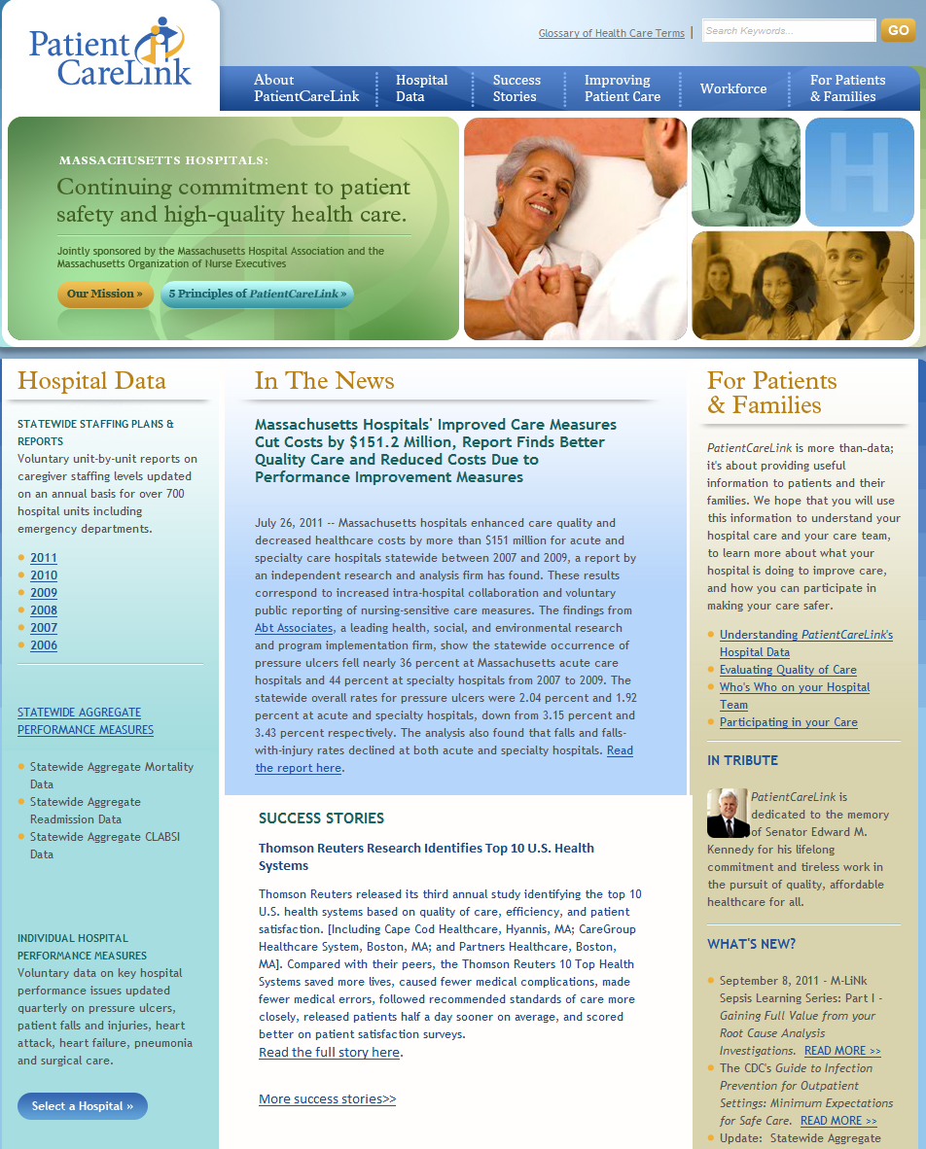
www.patientcarelink.org

Slide 25
MHA ‘s SPIA Evolves:
2013 Quality and Safety Goals
Reduce preventable hospital acquired conditions of CLABSI, CAUTI, and SSI by 40% by 2015
Reduce preventable readmissions by 20% by 2015
Notes:
The 40/20 Goal
Keep patients from getting injured or sicker.
Reduce preventable hospital-acquired conditions by 40%.
1.8 million fewer injuries to patients, with more than 60,000 lives saved over the next three years.
Help patients heal without complication.
Reduce hospital readmissions by 20% .
1.6 million patients will recover from illness without suffering a preventable complication requiring re-hospitalization within 30
days of discharge.

Slide 26
Quality and Patient Safety Division
Massachusetts Board of Registration in Medicine
Sharing Lessons Learned
Massachusetts Coalition for the Prevention of Medical Errors 15th Anniversary Celebration May 20, 2013
Tracy L. Gay, MHSA, JD
Director

Slide 27
PCA Regulations
Focus on Prevention of Patient Harm through Requirements for Programs in:
  Quality Assurance
  Risk Management
  Peer Review
  Identification of Substandard Practice
  Prevention of Substandard Practice
Assure Corporate and Physician Leadership in Programs.
243 CMR 3.00, et seq.

Slide 28
Health Care Facility Requirements
Health Care Facility Must Have Procedures to Identify & Analyze Patient Risk, including:
    internal incident reporting
    medical record audit
    data collection
    patient complaint process

Slide 29
QPS Division Activities
Assess how a health care facility is using its quality data to drive improvement.
Assess health care facility’s processes for review of quality & patient safety concerns.
Report results of assessment back to health care facility leadership, with emphasis on quality improvement/lessons learned.
Share health care facility quality initiatives and “lessons learned” through advisories, newsletters, workshops and expert panels.

Slide 30
QPS Division Newsletters
Examples of Articles
North Shore Medical Center – Accurate Weights in CHF Patients
(April 2013)
Children’s Hospital Boston – Evidence-based handoff program (December 2012)
NEBH & BIDMC – Preventing wrong site spine surgery (September 2012)
St. Vincent’s Hospital – Early ambulation in the ICU
(August 2012)
Boston Medical Center – Emergency airway response team
(April 2012)

Slide 31
QPS Division Advisories
Examples of Advisories
Robot-Assisted Surgery (March 2013)
Preoperative Assessment/Coordination of Care (January 2013)
Hydromorphone Advisory (September 2012)
Sharing HIPAA Protected Information for Quality Improvement Purposes (May 2012)
Assessing the Strength of Quality Improvement Actions (February 2012)
Interventional Radiology Complications (July 2011)
Notes:
31

Slide 32
QPS Division Task Forces
Physician Credentialing Expert Panel – February 2008
Competency–Based Credentialing Recommendations
Mastectomy/Breast Reconstruction Expert Panel – June 2011
Focus on implant-based reconstruction
Notes:
32

Slide 33
Results - Lessons Learned
Incredible learning is going on
Mechanism for sharing
Value demonstrated
Benefits aligned

Slide 34

Resource
Quality and Patient Safety Division, MA Board of Registration in Medicine:
http://www.mass.gov/eohhs/provider/licensing/occupational/physicans/quality-patient-safety/
Notes:
34

